Slide 1
Let`s Restore Nigeria`s Greatness Project
Presented by
Eric Thompson.

Slide 2
Whenever you hear or think about Nigeria what first comes to your mind?

Slide 3
Home?

Slide 4
Your Childhood?

Slide 5
Light, Water, Roads?

Slide 6
Education?

Slide 7
People suffering?

Slide 8
Security,
Corruptions & 419 ?
Notes:
Story …My encounter on the train with a lady/she ran when I told her I`m a Nigerian/despite that we had planned to meet for a date….

Slide 9
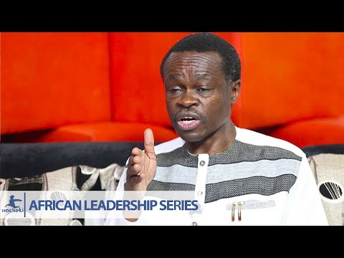
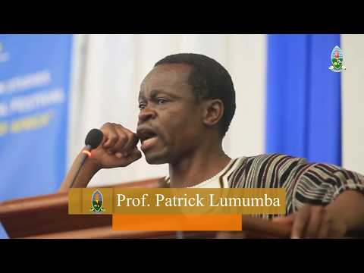
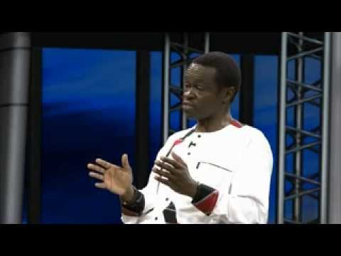
Notes:
Story …My encounter on the train with a lady/she ran when I told her I`m a Nigerian/despite that we had planned to meet for a date….

Slide 10
Story …My encounter on the train with a lady/she ran when I told her I`m a Nigerian/despite that we had planned to meet for a date….
I thought this is what happens when corruption invades the system.
Nigeria has been fundamentally badly corrupted.

Slide 11
Question!
How can we rebuild our image and=> make 9ja great again?

Slide 12
It is cheaper to prevent corruption than fight it _
Magu, the Acting Chairman EFCC.

Slide 13
This is a long term project

Slide 14
In 1983:
$1 = N 1 , £1=N2,
Volkswagen Beetle
= N8, 000
How much now?

Slide 15
Back then we had a booming economy. We were either the top, or among the top exporters, of timbre, cocoa, groundnuts, rubber,
palm oil, etc, in the world. Nigerians not only
holidayed at home in their villages, at Yankari Games Reserve, at Obudu Cattle Ranch, at Oguta Lake, at Ikogosi springs, at Gurara Falls, at Mambilla Platueau, etc, we attracted international tourists who brought in loads of foreign exchange. Even Nigerian schools were foreign exchange earners because they attracted foreign
students. “We had various car assembly plants – Peugeot,
Volkswagen, Anamco etc. Nigerian government officials only bought vehicles assembled in Nigeria for official cars. We had a thriving sports industry. We were not Man. United or Chelsea fans, we were Rangers or IICC fans. We had the Nduka Odizors, people made money from sports. We also had companies like Lennards and Bata
producing school shoes in their thousands, we had the thriving Nigerian Airways and the Aviation
School in the north that produced some of the best pilots in the world. In those days if you were
brilliant you were respected

Slide 16
What went wrong between then and now?

Slide 17
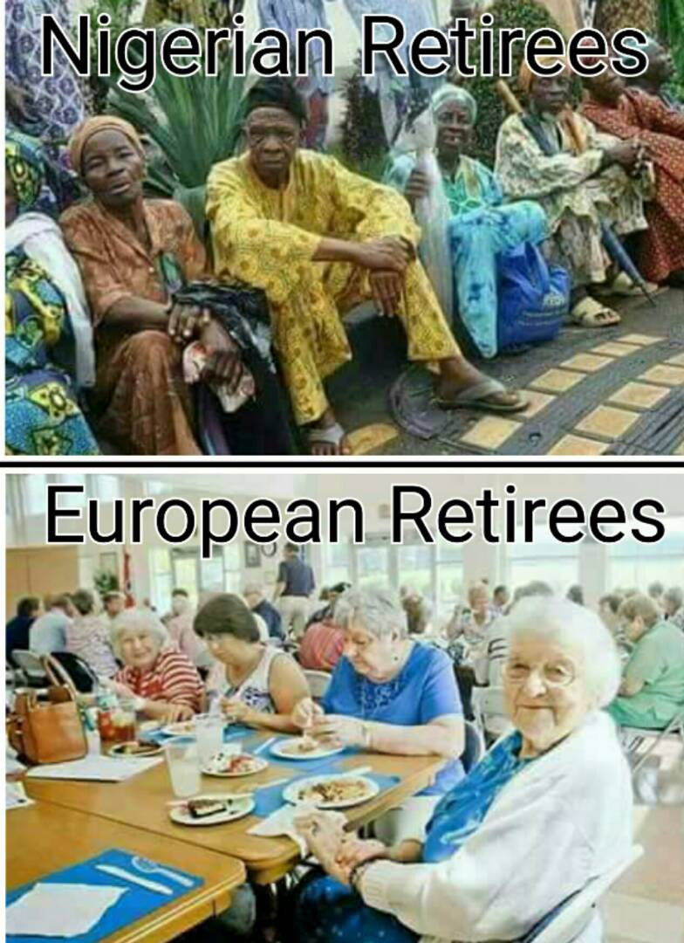
Take a look at these pictures

Slide 18
What is the difference?
Can`t we do it?
Don`t we have the resources to make it happen?

Slide 19
Bottom line on
How we can do it:

Slide 20
Purpose:
The purpose of this project is to completely eradicate corruption starting from the grassroots by training and educating them(young generation) through workshops, talks and seminars.

Slide 21
Bringing the truth to the next generation, that they may fulfill the hope and purpose of God the creator on the Nation. (Psalm 78:4&7.)Also 2 Chronicles 7:14 if my people, who are called by my name,……./ find a similar verses in Quran.

Slide 22
Approach:
Talks->effective curriculum on habits ->stories-your stories->facts and figures –>compare present situation with the expectations-> mix short simple Bible/Quran/traditional saying i.e. simple words of God + common sense (proverbs)-expected goals and mission /vision = Effective pure patriotic heart-purposeful life->hard work->slow and steady->nonstop->consistency

Slide 23
Requirements:
1.Team
1.a. Leadership summit in 9ja/Japan for leaders to various locations in 9ja.
b. give talks at schools Primary/J/HS & colleges.
2.To start with
a. 36 PCs.
b. 36 Printers.
c.36 Projectors
d. 36 Vans
e. 36 or 72 Officials
(36 represent number of states at the time of writing this).We may even start from one state and spread later after training the team.
3. Power points
( a. use a triangle as in aro meta../ b. Multiple intelligence/c. Rabbit and turtle d.Ask if Christian or Muslim; tell them it doesn`t matter here and use Psalm 78:1-8 especially 4&7)
4. Motivation
Meant for each state.

Slide 24
Procedure:
List of schools (public & private).
Give talks, seminars, workshops.
Duration 2 hours
Talk to / through churches
Employ people with integrity and background check.
Use PowerPoint presentations showing pictures of other countries in comparison with 9ja infrastructures such as
Education b. roads c. light
d. Communication system e.people
f. life/lifestyle g. Transportation system

Slide 25
Alternatively, we could;
Train >teachers ( a representative) from each region i.e.
East/north/ west/South
These people will in turn teach or train others in their regions.
They will be regularly coordinated / monitored/inspected for appropriate dissemination of information handed down to them.

Slide 26
Fund.( It takes a village)
Investors/Sponsors
NPO/NGO
TIDAC
Associations in JP / Nigerians in Diaspora etc. The intention is to involve all interested associations after introduction.

Slide 27
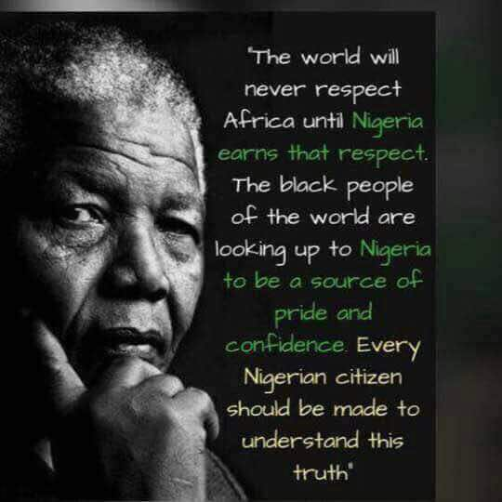

Slide 28
It`s time to thrive!
It`s time to really take Nigeria back and Make it Great Again!

Slide 29
https://youtu.be/7W2tl_FiZX8?t=2567
I know I can do it!
You can do it!
we will do it !
Let`s do it!
Thank you.

